Slide 3
Notes:
Briefly discuss the 12 recommendations
Discuss the rationale for moving forward with 5 for SY 24-25

Slide 4
Notes:
Discuss the
Why?
Rationale
Next Steps

Slide 5
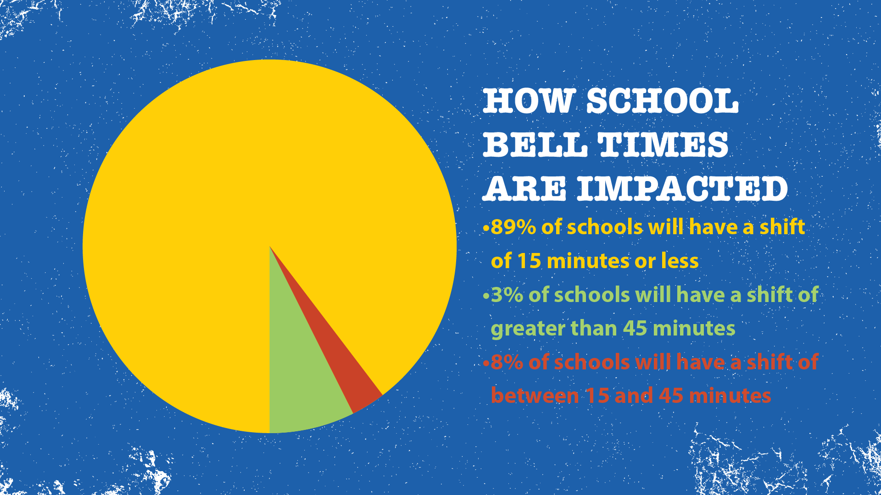
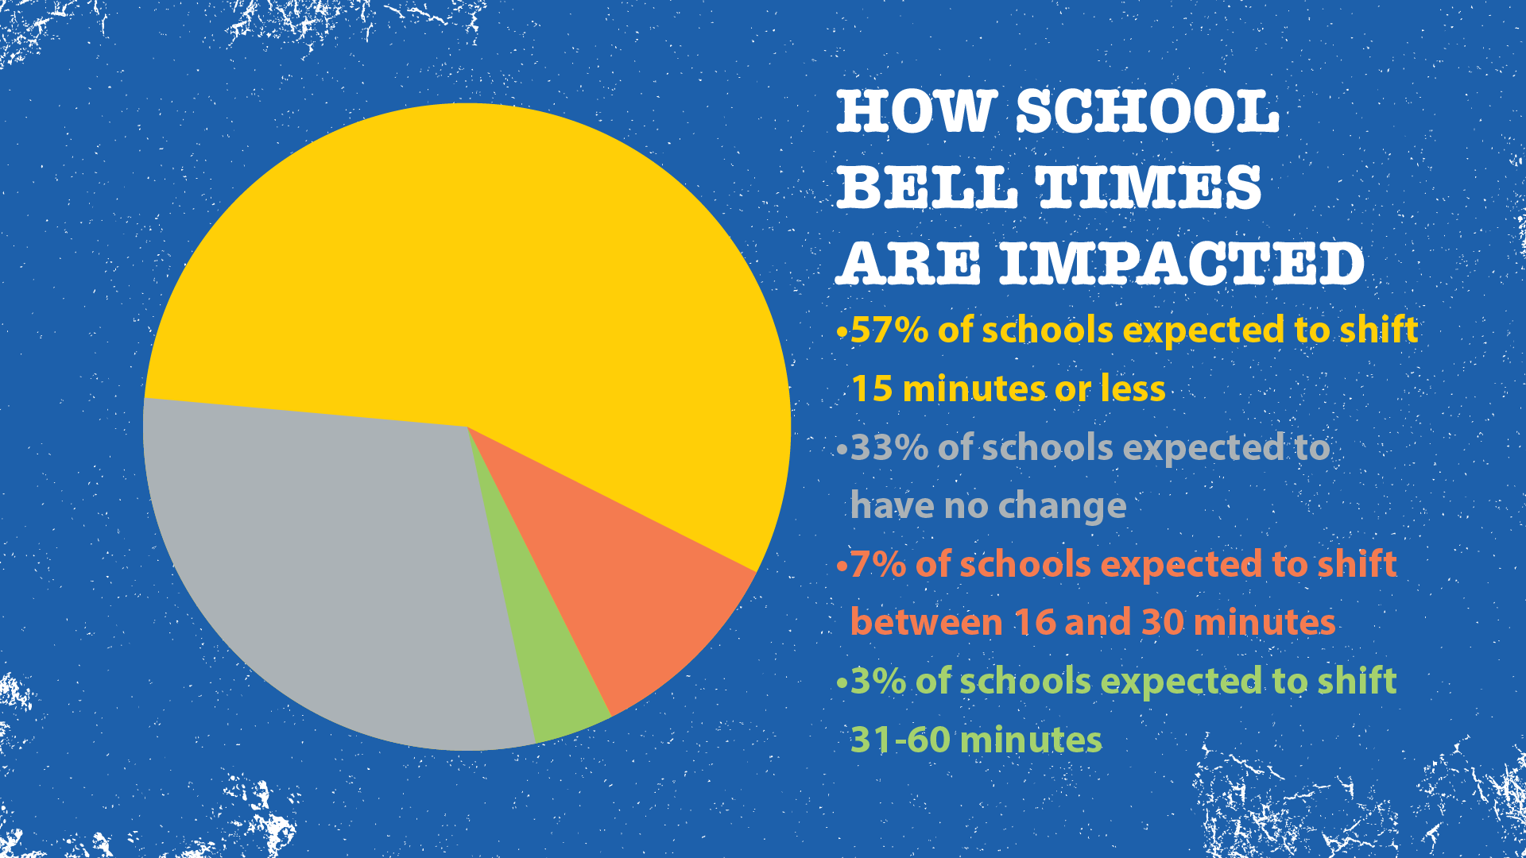
Notes:
90% of schools expected to have no change or a shift of 15 minutes or less.

Slide 6
Notes:
Discuss the
Why?
Rationale
Next Steps

Slide 7
Notes:
Discuss the
Why?
Rationale
Next Steps

Slide 8
Notes:
Discuss the
Why?
Rationale
Next Steps

Slide 9
Notes:
Discuss the big-picture customer service effort and how for families, the most relevant piece that impacts them day-to-day is the Here Comes the Bus App.
Discuss how the other 4 actions will make the bus app work effectively.
Discuss the
Why?
Rationale
Next Steps

Slide 10
Notes:
5 phase 1 actions to rollout SY 24-25
Phase 2 actions to rollout SY 25-26

